Slide 1
16 Bit Timer Counter
Lecture 6

Slide 2
Salient Features
Frequency generator
PWM generator
Timestamp for external events
Waveform generator

Slide 3
Important Registers
Timer Counter Register (TCNT1): 16 bits, holds the current count of the timer
Timer Counter Control Registers (TCCR1A, TCCR1B): Controls the timer in various ways (decides the timer mode, the kind of waveform generated etc)
Output Compare Register (OCR1A/B): The TCNT1 value is compared with OCR1A value. When the TCNT1 = OCR1A/B the timer can start counting from 0 again in some modes of operation, in others the compare match results in generation of a PWM output on the OC1A pin.
The Input Capture Register can capture the Timer/Counter value at a given external(edge triggered) event on either the Input Capture Pin (ICP1) or on the Analog Comparator pins (see “Analog Comparator” on page 200).

Slide 4
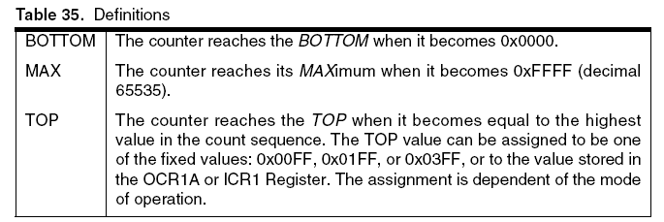
Important Constants

Slide 5
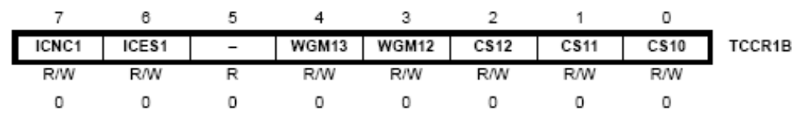
Timer Clock Frequencies
The Timer/Counter can be clocked directly by the system clock (by setting the CSn2:0 =1). This provides the fastest operation, with a maximum Timer/Counter clock frequency equal to system clock frequency (f_{CLK_I/O}). Alternatively, one of four taps from the prescaler can be used as a clock source. The prescaled clock has a frequency of either f_{CLK_I/O} /8, f_{CLK_I/O} /64, f_{CLK_I/O} /256, or f_{CLK_I/O} /1024.

Slide 6
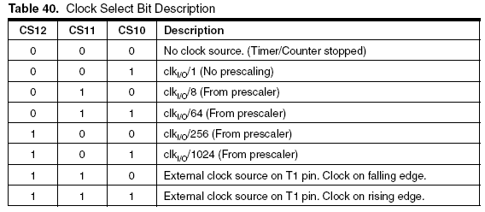
Timer Clock Frequencies

Slide 7
Timer Counting Modes
Normal Mode: The simplest mode of operation is the Normal mode. In this mode the counting direction is always up (incrementing), and no counter clear is performed. The counter simply overruns when it passes its maximum 16-bit value (MAX = 0xFFFF) and then restarts from the BOTTOM (0x0000).
Clear Timer on Compare (CTC) Mode: In Clear Timer on Compare or CTC mode the OCR1A or ICR1 Register are used to manipulate the counter resolution. In CTC mode the counter is cleared to zero when the counter value (TCNT1) matches either the OCR1A or the ICR1. The OCR1A or ICR1 define the TOP value for the counter, hence also its resolution.

Slide 8
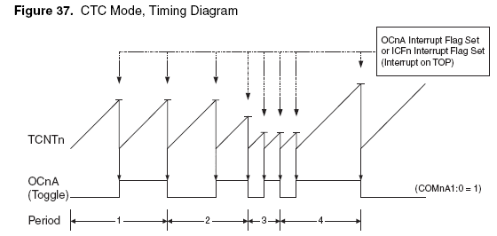
Counting Modes
For the time being do not worry about OCnA toggle etc. Just note that the horizontal lines on the TCNT ramp indicate that the OCR1A value has been reached and timer clears to 0

Slide 9
Counting Modes
The fast Pulse Width Modulation or fast PWM mode Provides a high frequency PWM waveform generation option. The fast PWM differs from the other PWM options by its single-slope operation. The counter counts from BOTTOM to TOP then restarts from BOTTOM.
In fast PWM mode the counter is incremented until the counter value matches either one of the fixed values 0x00FF, 0x01FF, or 0x03FF the value in ICR1 or the value in OCR1A (WGM13:0 = 15). The counter is then cleared at the following timer clock cycle.

Slide 10
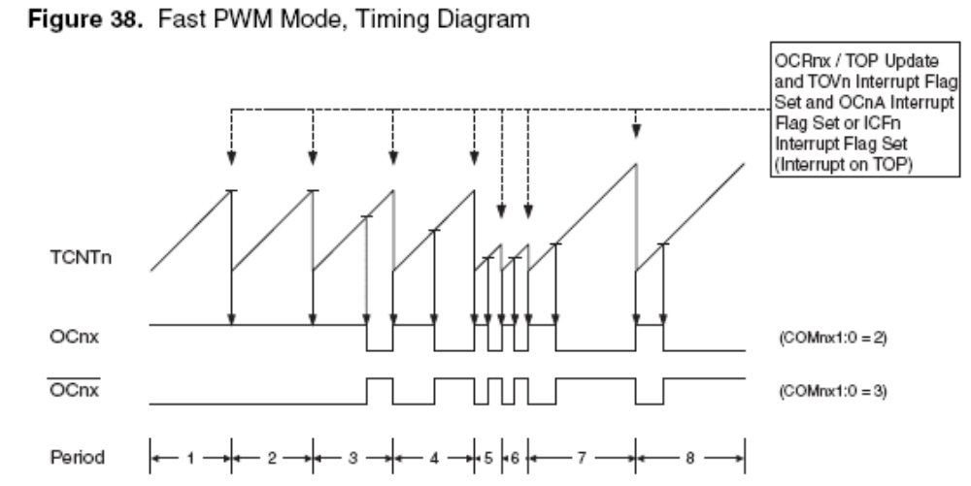
Counting Modes
Just observe that when TOP value is not decided by OCR1A register it is used to generate a PWM on the OCn pin. The horizontal lines on the ramp indicate when TCNT1 value equals OCR1A

Slide 11
Timer Interrupts
Output Compare Interrupt: The 16-bit comparator continuously compares TCNT1 with the Output Compare Register (OCR1x). If TCNT1 equals OCR1x the comparator signals a match. A match will set the Output Compare Flag (OCF1x) at the next timer clock cycle. If the OCIEx bit in the Timer Interrupt Mask register is enabled the Output Compare Flag generates an Output Compare interrupt.
Timer Overflow Interrupt: The Timer Overflow Flag (TOV1) is set whenever the counter reaches its TOP value in Normal, CTC, Fast PWM mode or reaches BOTTOM in the phase correct PWM, frequency and phase correct PWM modes. If TOV1 is set in Timer Interrupt Flag Register (TIFR) and Timer Overflow Interrupt Enable (TOIE) bit is set in TIMSK the Timer Overflow Interrupt is generated

Slide 12
Timer Interrupts
Input Capture Interrupt: When a change of the logic level (an event) occurs on the Input Capture Pin (ICP1), alternatively on the Analog Comparator Output (ACO), a capture will be triggered. When a capture is triggered, the 16-bit value of the counter (TCNT1) is written to the Input Capture Register (ICR1). The Input Capture Flag (ICF1) is set at the same system clock as the TCNT1 value is copied into ICR1 Register. If TICIE1 bit in the TIMSK register is set, the Input Capture Flag generates an Input Capture interrupt.

Slide 13
Waveform Generation on OCnx Pin
When the TCNT1 equals OCR1x the OCnx pin can be used to generate waveforms
For example in the CTC mode when the compare match occurs and the OC1x state as defined by the COM1x1:0 bits is in Toggle state we have a waveform as in slide 8
For example in the FastPWM mode when the compare match occurs and the OC1x state as defined by the COM1x1:0 bits is in Set or Reset state we have a waveform as in slide 9
The OC1x value will not be visible on the port pin unless the data direction for the pin is set to output (DDR_OC1x = 1).

Slide 14
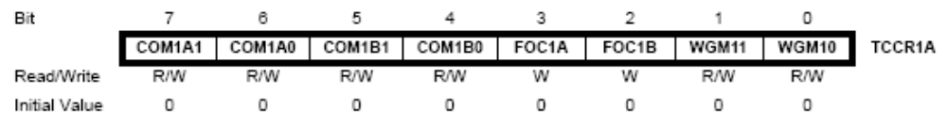
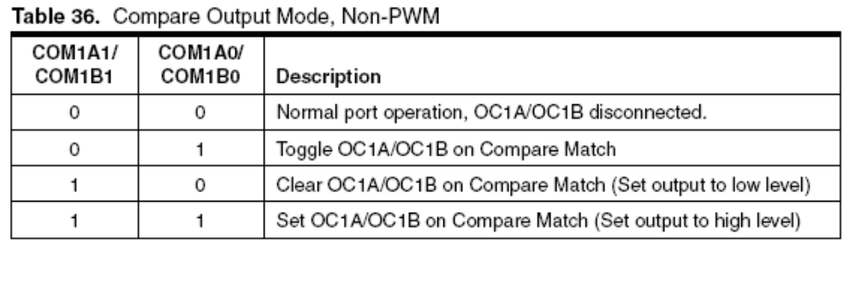
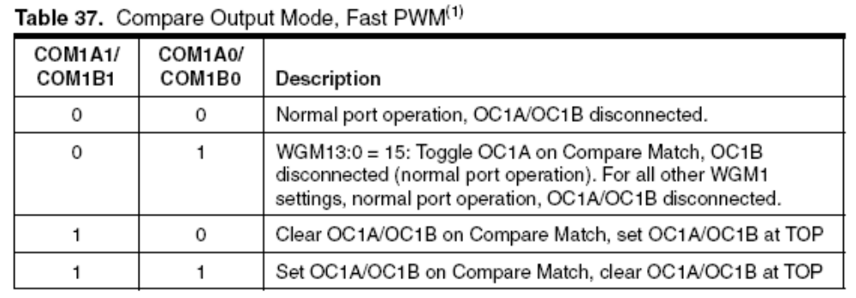
Waveform Details

Slide 15
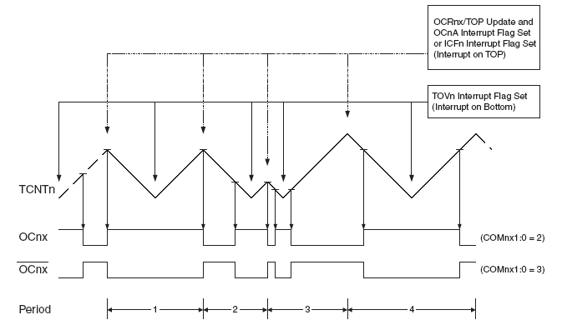
Phase Correct PWM
The Timer/Counter Overflow Flag (TOV1) is set each time the counter reaches BOTTOM. In phase correct PWM mode the counter is incremented until the counter value matches either one of the fixed values 0x00FF, 0x01FF, or 0x03FF (WGM13:0 = 1, 2, or 3), the value in ICR1 (WGM13:0 = 10), or the value in OCR1A (WGM13:0 = 11).

Slide 16
Phase Correct PWM
In non-inverting Compare Output mode, the Output Compare (OC1x) is cleared on the compare match between TCNT1 and OCR1x while upcounting, and set on the compare match while downcounting. In inverting Output Compare mode, the operation is inverted.

Slide 17
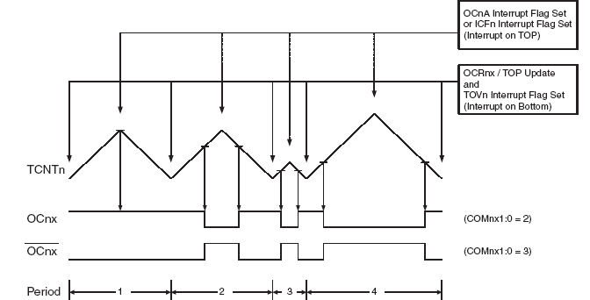
Phase and Frequency Correct PWM

Slide 18
A Servo Example by
Saurav Khurana
Requirement: Turn a servo in steps of r degrees till 360 degrees. The value r the minimum increment in the angle of the servo is decided by experimentation
The servo has 3 wires for its operation(not necessarily in the same order)
  Vcc: Power
  Signal/Control: PWM pulse is the input here
  Gnd: Signal Ground
The Home position of the servo corresponds to a pulse width of 1.5ms. This high pulse given to the servo should be given to it at-least every 20ms. Here it is done every 12.5ms
The pulse width (W) is proportional to angle required for the servo to rotate to a required amount and the proportionality factor is calculated by hit and trial method i.e.
  W = 1.5ms + k*(angle)
  The value of k is close to 6 (actually it is fractional)
  Here it corresponds to the variable stepTime.

Slide 19
A Servo Example
The timer clears at every 12.5ms by the corresponding value set in OCR1A register
The TCNT1 register value is also compared with the value stored in OCR1B register. The OCR1B register stores the high time of the pulse. Till such time pin4 of PORTD is set HIGH, after which its set LOW for the remaining time till 12.5ms
The high time of the pulse varies with angle and is computed as in previous slide

Slide 20


Register Description

Slide 21

Register Description for Code

Slide 22
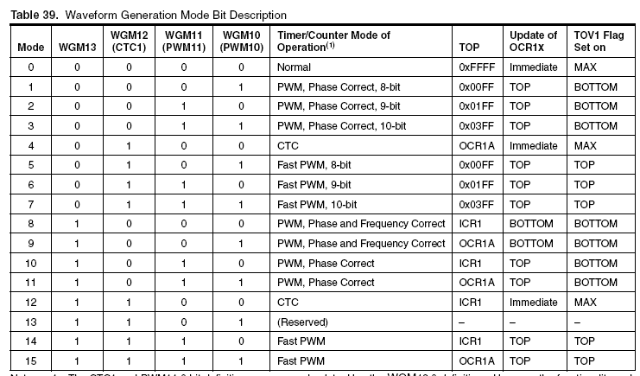
Register Description for Code

Slide 23
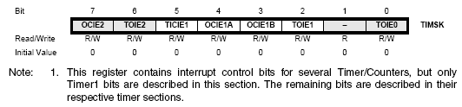
Register Description for Code

